Slide 1
Section 1.4 Simplifying Rational Expressions and NPV’s
© Copyright all rights reserved to Homework depot: www.BCMath.ca

Slide 2
I) Non-Permissible Values (NPV)
Permissible → Allowed, Non Permissible → Not Allowed
When evaluating rational expressions, the denominator is not allowed to be Zero, because:
Can’t divide by zero → Undefined!!
Any value of “x” (variable) that makes the denominator equal to zero is called a NPV
When finding the Non-Permissible Values
Take the entire denominator
Make it equal to zero
Then solve for “x” (variable)
Factor the denominator
These are values that “x” can not be (Not Permissible!)
© Copyright all rights reserved to Homework depot: www.BCMath.ca

Slide 3
Ex: Find the NPV for each Expression
For which value(s) of the variable is each expression undefined
Denominator
Factor
Equal to zero
Solve for “x”
“x” can NOT be 1/3, otherwise the expression will be undefined
© Copyright all rights reserved to Homework depot: www.BCMath.ca

Slide 4
Practice: Find the NPV
Factor
Factor
© Copyright all rights reserved to Homework depot: www.BCMath.ca

Slide 5
III) Simplifying R.E. with Binomials
You can only cancel out a binomial only when it’s a common factor in both the Numerator & Denominator
Can’t cancel, b/c the binomials are not the same
When there’s a trinomial or a difference of squares in the expression, factor them first
Then cancel out any common factors or binomials in both the top & bottom
Factor the expression
Cancel out any common factors

Slide 6
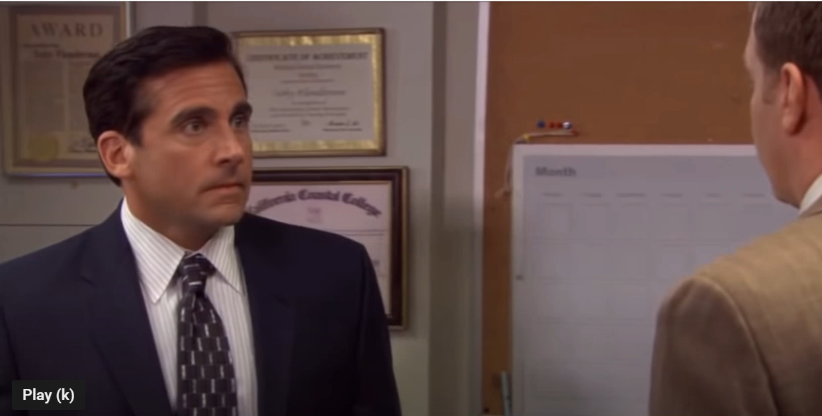
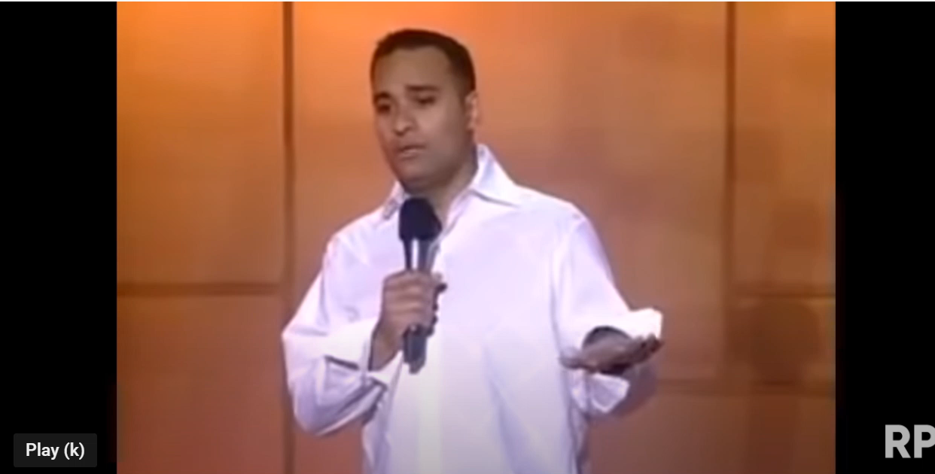
Common BIG MISTAKES!!!
YOU can not cancel a common term from the top and bottom if it is added or subtracted!
NOOO!! nNoo….noo….
NOOO!! Same reason, can’t cancel the x’s like this
ALSO NO!!!!
You can’t cancel the “x’s” because they are added to another term on top and bottom
3 minutes of people saying “NO” in movies……

Slide 7
Practice: Factor and Simplify
Factor the expression
Cancel out any common factors

Slide 8
II) Multiplying & Dividing Rational Expressions
When multiplying or dividing Rational expressions:
Factor every trinomial or difference of squares
Cancel out any common binomial in both the numerator & denominator
When looking NPV’s , check every bracket that is in the denominator
Ex: Simplify & State the NPV
Factor each trinomial
Cancel out any common binomial
Look for NPV’s (Denominator)
© Copyright all rights reserved to Homework depot: www.BCMath.ca

Slide 9
Practice: Simplify & find all NPV’s
Look for NPV’s (Denominator)
Look for NPV’s (Denominator)
© Copyright all rights reserved to Homework depot: www.BCMath.ca

Slide 10
Ex: FIND all the NPV’s:

Slide 11
What are the NPV’s?
Ex: Simplify and Find All the NPV’s

Slide 12
Ex: Simplify and Find All the NPV’s
The non-permissible values are for x are

Slide 13
Extra Practice: Simplify each of the following and state the NPV’s

Slide 14
III) Adding & Subtracting R.E. with Binomials in the Denominator
TO add or subtract two rational expressions, they MUST have a COMMON DENOMINATOR!
To find the Lowest Common Denominator, look at all the binomials in every denominator
Ex: FIND the LCD and then ADD or Subtract the Rational Expressions:
LCD
LCD
© Copyright all rights reserved to Homework depot: www.BCMath.ca

Slide 15
Practice: Simplify
LCD
LCD
© Copyright all rights reserved to Homework depot: www.BCMath.ca

Slide 16
Practice: Simplify
Note: Make sure to factor the denominator first to find the LCD
© Copyright all rights reserved to Homework depot: www.BCMath.ca

Slide 17
Practice: Simplify & state the NPV
NPV:
© Copyright all rights reserved to Homework depot: www.BCMath.ca

Slide 18
The work below is shown by a student to reduce a rational equation. Where did the student make a mistake?
Step 2 is incorrect because factoring is not simplifying
Step 3 is incorrect because you cannot cancel out the “x’s” with two x’s on top
Step 3 is incorrect because the bottom is a binomial
Step 4 is incorrect because the expression is not simplified
Step 4 is incorrect because the 3’s on top and bottom can be cancelled out

Slide 19
The work below is shown by a student to reduce a rational equation. Where did the student make a mistake?
Step 2 is incorrect because it’s factored incorrectly
Step 2 is wrong because the x² can be cancelled out
Step 3 is incorrect because it is factored incorrectly
Step 4 is incorrect because the expression is can be not simplified
Step 6 is wrong because it should be negative
There are no mistakes on any steps

